Slide 1
Static Benchmarks
Executing standard computations periodically
Updated
Benchmarks
Computational Model Object
CPU / GPU
Decision
Operating System
Current System Utilization

Slide 2






Computation attributes
Library
Implementation
Current workload from OS
Library
Interface
Main Program
Benchmark Updater
Interface
Benchmark Updater
Thread
Stored Benchmarks
Re-evaluate periodically
Revised Benchmarks

Slide 3


Time
Benchmark
GPU
CPU
Computational model weight

Slide 4
Task 1
Task 2
Task 3
Task 4
Task 5
Task 6
Task 7
Task 8
Task 9
Task 10
Task 11
Task 12
Task 13
---
---
Task 48
Task 49
Task 50

Slide 5
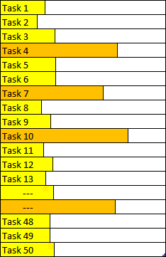
Input flow
Sample Count
CPU
T_{CPU}
No
T_{CPU} < T_{GPU}
Sample Count
GPU
Yes
T_{GPU}
GPU
REVISE_COUNT
CPU

Slide 6
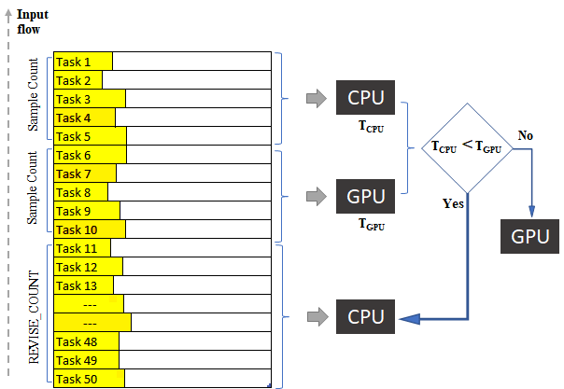
Array Size | Host Time | Device Time
100 | 0.00212 | 0.000396
200 | 0.00445 | 0.000237
-- | -- | --
800 | 0.016053 | 0.000225
900 | 0.017672 | 0.000222
1000 | 0.019177 | 0.000228
1100 | 0.02091 | 0.000227
1200 | 0.026685 | 0.000225
1300 | 0.025931 | 0.000261
Array Size | Host Time | Device Time
100 | 0.00212042 | 0.00039633
200 | 0.00444981 | 0.00023719
-- | -- | --
800 | 0.01605261 | 0.000225
900 | 0.0176719 | 0.00022228
1000 | 0.01917692 | 0.0002281
1100 | 0.02090968 | 0.00022673
1200 | 0.02668534 | 0.00022467
1300 | 0.02593127 | 0.00026113

Slide 7
i = 1
RC += 1 * STEP
i = 2
RC += 2 * STEP
i = 0
RC = MIN (reset)
RC = MIN
CPU
CPU
CPU
GPU

Slide 8
Matrix B
Matrix C
Matrix A
=
X
y
x
z
z
x
y

Slide 9




>
CPU Won

Slide 10
Input flow
Sample Count
CPU
T_{CPU}
No
T_{CPU} < T_{GPU}
Sample Count
GPU
Yes
T_{GPU}
GPU
REVISE_COUNT
CPU

Slide 11

Application
ML_Trainer
1 *
1 uses 1
ComputationalModel
1 *
1 uses 1
Dumped model(s)
ConcreteModel
ML_Model

Slide 12
Application
ComputationalModel
GPU_Implementation() CPU_Implementation()
getAttributes()
1 *
ML_Trainer
1 writes 1
Logger
1 *
ML_Model
1 writes 1
Dumped model(s)
ConcreteModel

Slide 13
Application
Application
ComputationalModel
Execute()
GPU_Implementation() CPU_Implementation()
getAttributes()
Logger
ML_Model
Logger
ML_Model
ConcreteModel
setData()

Slide 14
Cache array empty
or
Input weights not in cache
Yes
ML prediction
No
Outlier
Is prediction CPU?
No
Run on GPU
Run on CPU
Yes
Replace a cache
Run on CPU

Slide 15
ComputationalModel
-static long tCPU = 0; -static long tGPU = 0;
+execute(int mode) +updateResults(start, stop, processor) #GPU_Implementation() #CPU_Implementation()

Slide 16
Input flow
Sample Count
CPU
T_{CPU}
No
T_{CPU} < T_{GPU}
Sample Count
GPU
Yes
T_{GPU}
GPU
REVISE_COUNT
CPU

Slide 17
Time
Initial Cost
Weight of Computation

Slide 18
1
2
2 1
5
8
2 5
2
0 1
ML
X
Hashing to find cache slot “i”
ML

Slide 19
attr_array
<32,32,32>
<32, 32, 8>
* | * | * | * | * | * | * | * | * | * | * | * | * | * | *
0 | 1 | 2 | 3 | 4 | 5 | 6 | 7 | 8 | 9 | 10 | 11 | 12 | 13 | 14
predicts_array
CACHE_SIZE = 15
Input attr = <32,32,32>
i = (32 + 32 + 32) % 15
= 6
if( attr_array [ i ] == attr)
return predicts_array [ i ]

Slide 20
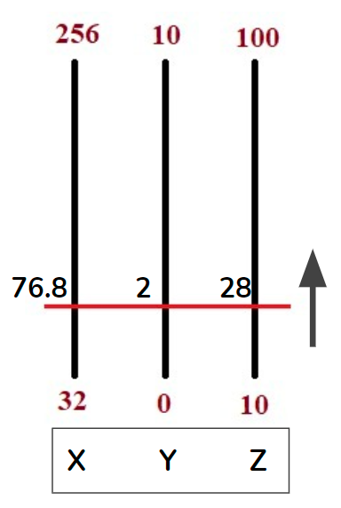
Prediction Process
Dataset
Trained Models
Train or Load
getAttributes()
= <80, 8, 40>
Attributes crosses
Boundary
Trained ML
Model
Attributes separated by Boundary
GPU | CPU

